Slide 1
Chapter 18: Searching and Sorting Algorithms
Java Programming:
Program Design Including Data Structures

Slide 2
Chapter Objectives
Learn the various search algorithms
Explore how to implement the sequential and binary search algorithms
Discover how the sequential and binary search algorithms perform
Learn about asymptotic and big-O notation

Slide 3
Chapter Objectives (continued)
Become aware of the lower bound on comparison-based search algorithms
Learn the various sorting algorithms
Explore how to implement the selection, insertion, quick, merge, and heap sorting algorithms
Discover how the sorting algorithms discussed in this chapter perform

Slide 4
Searching and Sorting Algorithms Interface
All algorithms described are generic
Searching and sorting require comparisons of data
  They should work on the type of data with appropriate methods to compare data items
All algorithms described are for array-based lists except merge sort
Class SearchSortAlgorithms will implement methods in this interface

Slide 5
Search Algorithms
Each item in a data set has a special member that uniquely identifies the item in the data set
  Called the key of the item
Keys are used in operations such as: searching, sorting, inserting, and deleting
Analysis of algorithms involves counting the number of key comparisons
  The number of times the key of the search item is compared with the keys in the list

Slide 6
Sequential Search
public int seqSearch(T[] list, int length, T searchItem)
{
int loc;
boolean found = false;
for (loc = 0; loc < length; loc++)
{
if (list[loc].equals(searchItem))
{
found = true;
break;
}
}
if (found)
return loc;
else
return -1;
} //end seqSearch

Slide 7
Sequential Search Analysis
The statements in the for loop are repeated several times
  For each iteration of the loop, the search item is compared with an element in the list
When analyzing a search algorithm, you count the number of key comparisons
Suppose that L is a list of length n
The number of key comparisons depends on where in the list the search item is located

Slide 8
Sequential Search Analysis (continued)
Best case
  The item is the first element of the list
  You make only one key comparison
Worst case
  The item is the last element of the list
  You make n key comparisons
You need to determine the average case

Slide 9
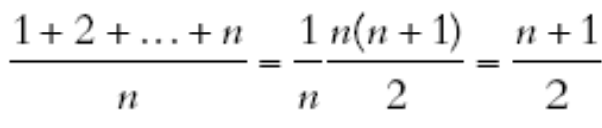
Sequential Search Analysis (continued)
To determine the average case
  Consider all possible cases
  Find the number of comparisons for each case
  Add them and divide by the number of cases
Average case
  On average, a successful sequential search searches half the list

Slide 10
Binary Search
Method binarySearch
public int binarySearch(T[] list, int length, T searchItem)
{
int first = 0;
int last = length - 1;
int mid = -1;
boolean found = false;
while (first <= last && !found)
{
mid = (first + last) / 2;
Comparable<T> compElem = (Comparable<T>) list[mid];

Slide 11
Binary Search (continued)
Method binarySearch
if (compElem.compareTo(searchItem) == 0)
found = true;
else
if (compElem.compareTo(searchItem) > 0)
last = mid - 1;
else
first = mid + 1;
}
if (found)
return mid;
else
return -1;
}//end binarySearch

Slide 12
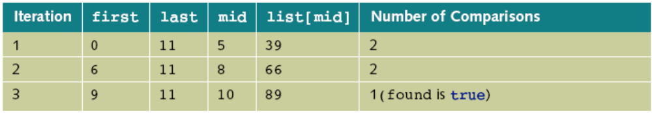
Binary Search (continued)
Figure 18-1 Sorted list for a binary search
Table 18-1 Values of first, last, and middle and the Number of
Comparisons for Search Item 89

Slide 13
Performance of Binary Search
Suppose that L is a sorted list of size n
  And n is a power of 2 (n = 2^{m})
After each iteration of the for loop, about half the elements are left to search
The maximum number of iteration of the for loop is about m + 1
  Also m = log₂n
Each iteration makes two key comparisons
  Maximum number of comparisons: 2(m + 1)

Slide 14
Binary Search Algorithm and the class OrderedArrayList
Class OrderedArrayList
public class OrderedArrayList<T> extends ArrayListClass<T>
{
//The definitions of the constructors and other methods is
//the same as before.
public int binarySearch(T searchItem)
{
SearchSortAlgorithms<T> searchObject
= new SearchSortAlgorithms<T>();
return searchObject.binarySearch(list, length,
searchItem);
}
}

Slide 15
Asymptotic Notation: Big-O Notation
Consider the following algorithm
System.out.print(“Enter the first number: “); //Line 1
num1 = console.nextInt(); //Line 2
System.out.println(); //Line 3
System.out.print(“Enter the second number: “); //Line 4
num2 = console.nextInt(); //Line 5
System.out.println(); //Line 6
if (num1 >= num2) //Line 7
max = num1; //Line 8
else //Line 9
max = num2; //Line 10
System.out.println(“The maximum number is: “
+ max); //Line 11

Slide 16
Asymptotic Notation: Big-O Notation (continued)
The previous algorithm executes 5 operations
In this algorithm, the number of operations executed is fixed
Now, consider the following algorithm

Slide 17
Asymptotic Notation: Big-O Notation (continued)
System.out.println(“Enter positive integers “
+ “ending with -1”); //Line 1
count = 0; //Line 2
sum = 0; //Line 3
num = console.nextInt(); //Line 4
while (num != -1) //Line 5
{
sum = sum + num; //Line 6
count++; //Line 7
num = console.nextInt(); //Line 8
}
System.out.println(“The sum of the numbers is: “
+ sum); //Line 9
if (count != 0) //Line 10
average = sum / count; //Line 11
else //Line 12
average = 0; //Line 13
System.out.println(“The average is: “
+ average); //Line 14

Slide 18
Asymptotic Notation: Big-O Notation (continued)
The previous algorithm executes 5n + 11 or 5n + 10 operations
  Where n is the number of iterations performed by the loop
In these expressions, 5n becomes the dominating term
  For large values of n
  The terms 11 and 10 become negligible

Slide 19
Asymptotic Notation: Big-O Notation (continued)
Suppose that an algorithm performs f(n) basic operations to accomplish a task
  Where n is the size of the problem
f(n) gives you the efficiency of the algorithm
  Different algorithms may have different efficiency functions
  You can create a comparison table

Slide 20
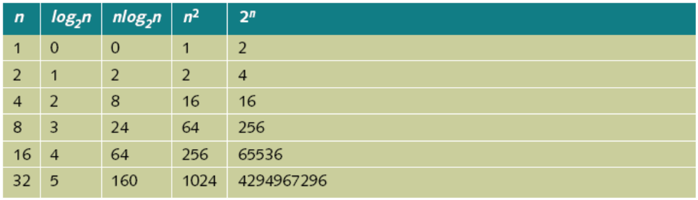
Asymptotic Notation: Big-O Notation (continued)
Table 18-4 Growth Rate of Various Functions

Slide 21
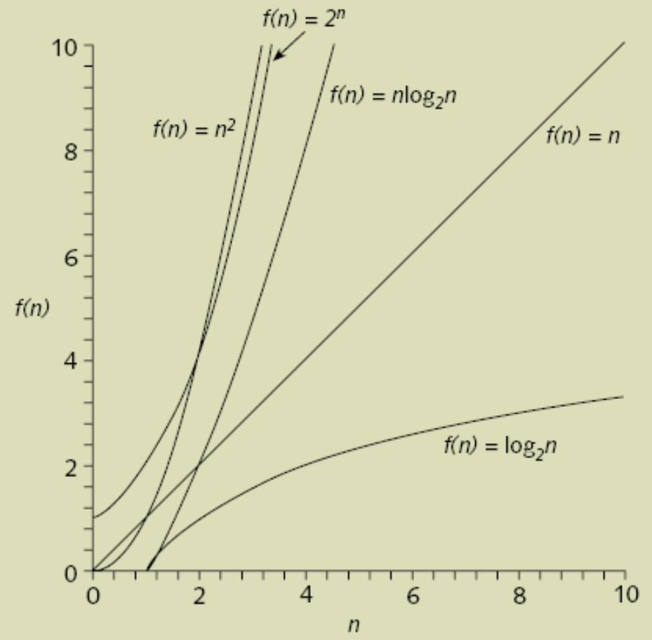
Asymptotic Notation: Big-O Notation (continued)
Figure 18-9 Growth Rate of Various Functions

Slide 22
Asymptotic Notation: Big-O Notation (continued)
Asymptotic means the study of the function f as n becomes larger and larger without bound
Consider two functions g(n) = n² and f(n) = n² + 4n + 20
  As n becomes larger and larger, the term 4n + 20 in f(n) becomes insignificant
  You can predict the behavior of f(n) by looking at the behavior of g(n)

Slide 23
Asymptotic Notation: Big-O Notation (continued)
If an algorithm complexity function is similar to f(n), you can say that the function is of O(n²)
  Called Big-O of n²
f(n) = O(g(n)), if there exist positive constants c and n₀ such that:
  f(n) ≤ cg(n) for all n ≥ n₀

Slide 24
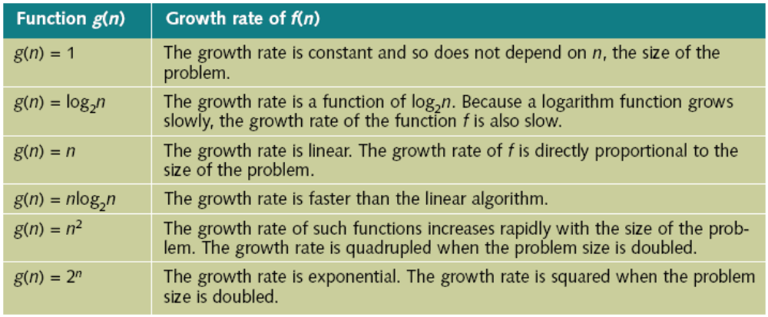
Asymptotic Notation: Big-O Notation (continued)
Table 18-7 Some Big-O Functions That Appear in Algorithm Analysis

Slide 25
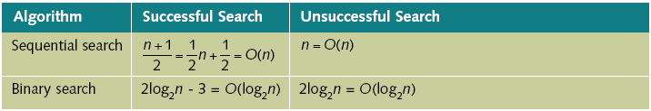
Asymptotic Notation: Big-O Notation (continued)
Table 18-8 Number of Comparisons for a List of Length n

Slide 26
Lower Bound on Comparison-Based Search Algorithms
Sequential and binary search algorithms search the list by comparing elements
  These algorithms are called comparison-based search algorithms
Sequential search is of the order n
Binary search is of the order log₂n
You cannot design a comparison-based search algorithm of an order less than log₂n

Slide 27
Sorting Algorithms
There are several sorting algorithms in the literature
You can analyze their implementations and efficiency

Slide 28
Sorting a List: Bubble Sort
Method bubbleSort
public void bubbleSort(T list[], int length)
{
for (int iteration = 1; iteration < length; iteration++)
{
for (int index = 0; index < length - iteration; index++)
{
Comparable<T> compElem = (Comparable<T>) list[index];
if (compElem.compareTo(list[index + 1]) > 0)
{
T temp = list[index];
list[index] = list[index + 1];
list[index + 1] = temp;
}
}
}
}//end bubble sort

Slide 29
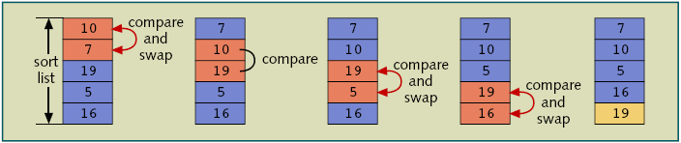
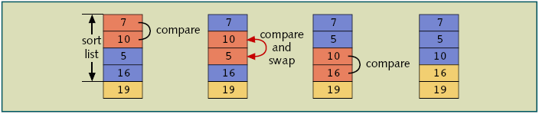
Sorting a List: Bubble Sort (continued)
Figure 18-11 Elements of list during the first iteration
Figure 18-12 Elements of list during the second iteration

Slide 30
Analysis: Bubble Sort
A sorting algorithm makes key comparisons and also moves the data
  You look for both operations to analyze a sorting algorithm
The outer loop executes n – 1 times
  For each iteration, the inner loop executes a certain number of times
  There is one comparison per each iteration of the outer loop

Slide 31
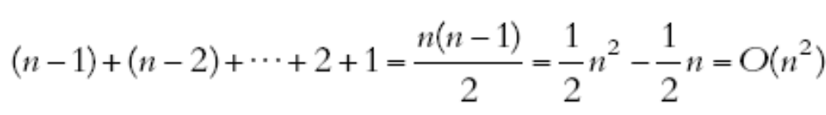

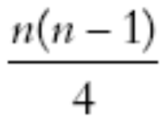
Analysis: Bubble Sort (continued)
Total number of comparisons (general case)
Average number of assignments
Total number of comparisons (book’s method)

Slide 32
Selection Sort: Array-Based Lists
Sorts a list by
  Selecting the smallest element in the (unsorted portion of the list)
  Moving this smallest element to the top of the list

Slide 33
Selection Sort: Array-Based Lists (continued)
Method minLocation
private int minLocation(T[] list, int first, int last)
{
int minIndex = first;
for (int loc = first + 1; loc <= last; loc++)
{
Comparable<T> compElem = (Comparable<T>) list[loc];
if (compElem.compareTo(list[minIndex]) < 0)
minIndex = loc;
}
return minIndex;
}//end minLocation

Slide 34
Selection Sort: Array-Based Lists (continued)
Methods swap and selectionSort
private void swap(T[] list, int first, int second)
{
T temp;
temp = list[first];
list[first] = list[second];
list[second] = temp;
}//end swap
public void selectionSort(T[] list, int length)
{
for (int index = 0; index < length - 1; index++)
{
int minIndex = minLocation(list, index, length - 1);
swap(list, index, minIndex);
}
}//end selectionSort

Slide 35
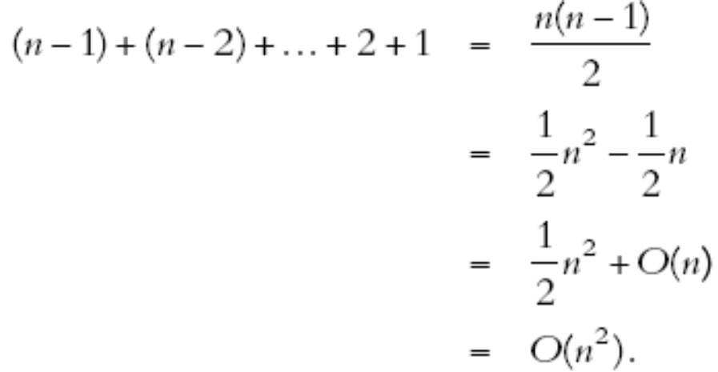
Analysis: Selection Sort
Number of item assignments: 3(n – 1) = O(n)
Number of key comparisons:
Selection sort does not depend on the initial arrangement of the data

Slide 36
Insertion Sort: Array-Based Lists
Sorts a list by
  Moving each element to its proper place in the sorted portion of the list
Tries to improve the performance of the selection sort
  Reduces the number of key comparisons

Slide 37
Insertion Sort: Array-Based Lists (continued)
Method insertionSort
public void insertionSort(T[] list, int length)
{
for (int firstOutOfOrder = 1; firstOutOfOrder < length;
firstOutOfOrder ++)
{
Comparable<T> compElem =
(Comparable<T>) list[firstOutOfOrder];
if (compElem.compareTo(list[firstOutOfOrder - 1]) < 0)
{
Comparable<T> temp =
(Comparable<T>) list[firstOutOfOrder];

Slide 38
Insertion Sort: Array-Based Lists (continued)
int location = firstOutOfOrder;
do
{
list[location] = list[location - 1];
location--;
}
while (location > 0 &&
temp.compareTo(list[location - 1]) < 0);
list[location] = (T) temp;
}
}
}//end insertionSort

Slide 39
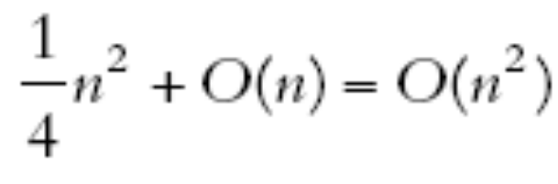
Analysis: Insertion Sort
Average number of item assignments and key comparisons:

Slide 40
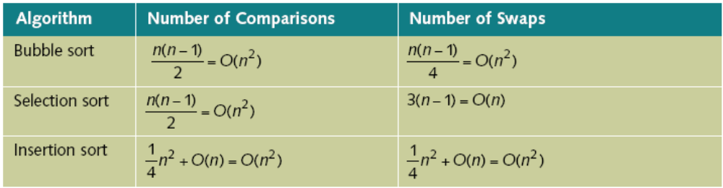
Analysis: Insertion Sort (continued)
Table 18-9 Average Case Behavior of the Bubble Sort, Selection Sort,
and Insertion Sort Algorithms for a List of Length n

Slide 41
Lower Bound on Comparison-Based Sort Algorithms
Selection and insertion sort algorithms are comparison-based sort algorithms
  With an average-case behavior of O(n²)
You can trace the execution of a comparison-based algorithm by using a graph called a comparison tree
  The comparison tree is a binary tree
Any sorting algorithm that sorts a list by comparison of the keys only, in its worst case, makes at least O(nlog₂n) key comparisons

Slide 42
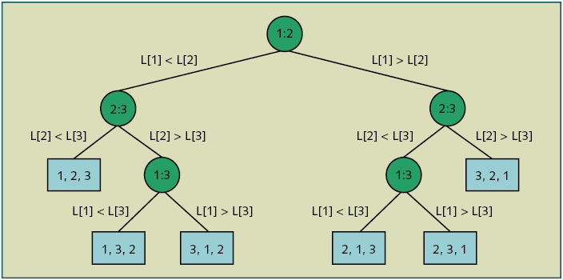
Lower Bound on Comparison-Based Sort Algorithms (continued)
Figure 18-36 Comparison tree for sorting three times

Slide 43
Quick Sort: Array-Based Lists
General algorithm
if (the list size is greater than 1)
{
a. Partition the list into two sublists, say lowerSublist and
upperSublist.
b. Quick sort lowerSublist.
c. Quick sort upperSublist.
d. Combine the sorted lowerSublist and sorted upperSublist.
}

Slide 44

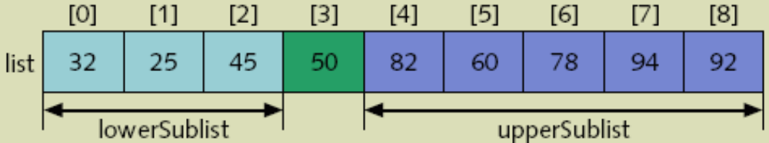
Quick Sort: Array-Based Lists (continued)
Figure 18-37 list before the partition
Figure 18-38 list after the partition

Slide 45
Quick Sort: Array-Based Lists (continued)
Method partition
private int partition(T[] list, int first, int last)
{
T pivot;
int smallIndex;
swap(list, first, (first + last) / 2);
pivot = list[first];
smallIndex = first;
for (int index = first + 1; index <= last; index++)
{
Comparable<T> compElem = (Comparable<T>) list[index];
if (compElem.compareTo(pivot) < 0)
{
smallIndex++;
swap(list, smallIndex, index);
}
}
swap(list, first, smallIndex);
return smallIndex;
}//end partition

Slide 46
Quick Sort: Array-Based Lists (continued)
Method swap and recQuickSort
private void swap(T[] list, int first, int second)
{
T temp;
temp = list[first];
list[first] = list[second];
list[second] = temp;
}//end swap
private void recQuickSort(T[] list, int first, int last)
{
if (first < last)
{
int pivotLocation = partition(list, first, last);
recQuickSort(list, first, pivotLocation - 1);
recQuickSort(list, pivotLocation + 1, last);
}
}//end recQuickSort

Slide 47
Quick Sort: Array-Based Lists (continued)
Method quickSort
public void quickSort(T[] list, int length)
{
recQuickSort(list, 0, length - 1);
}//end quickSort

Slide 48
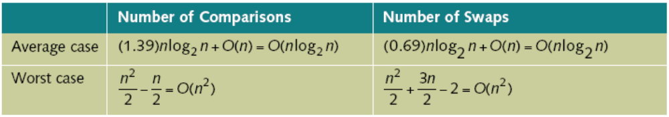
Analysis: Quick Sort
Table 18-10 Analysis of the Quick Sort Algorithm for a List of Length n

Slide 49
Merge Sort: Linked List-Based Lists
General algorithm
if the list is of size greater than 1
{
a. Divide the list into two sublists.
b. Merge sort the first sublist.
c. Merge sort the second sublist.
d. Merge the first sublist and the second sublist.
}

Slide 50
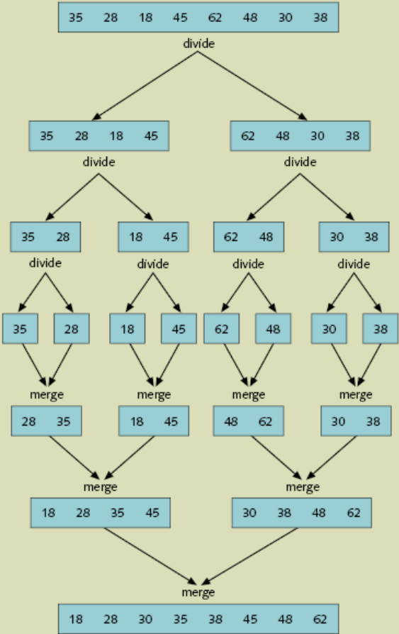
Merge Sort: Linked List-Based Lists (continued)
Figure 18-48 Merge sort algorithm

Slide 51
Divide
General steps
  Find the middle node
    Since you don’t know the size of the list, you have to traverse it until you reach the middle node
  Divide the list into two sublists of nearly equal size

Slide 52
Merge
General steps
  Compare the elements of the sorted sublists
  Adjust the references of the nodes with the smaller info

Slide 53
Merge (continued)
Method recMergeSort
private LinkedListNode<T> recMergeSort(LinkedListNode<T> head)
{
LinkedListNode<T> otherHead;
if (head != null) //if the list is not empty
if (head.link != null) //if the list has more
//than one node
{
otherHead = divideList(head);
head = recMergeSort(head);
otherHead = recMergeSort(otherHead);
head = mergeList(head, otherHead);
}
return head;
}//end recMergeSort

Slide 54
Merge (continued)
Method mergeSort
public void mergeSort()
{
first = recMergeSort(first);
if (first == null)
last = null;
else
{
last = first;
while (last.link != null)
last = last.link;
}
} //end mergeSort

Slide 55
Analysis: Merge Sort
The maximum number of comparisons is
O(nlog₂n)
  This applies for both the worst and the average case

Slide 56
Heap Sort: Array-Based Lists
A heap is a list in which each element contains a key
  The key in the element at position k in the list is at least as large as the key in the element at position 2k + 1, and 2k + 2
Given a heap, you can construct a complete binary tree
After you convert the array into a heap, the sorting phase begins

Slide 57
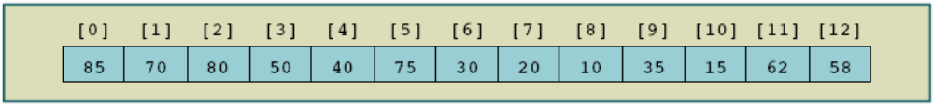
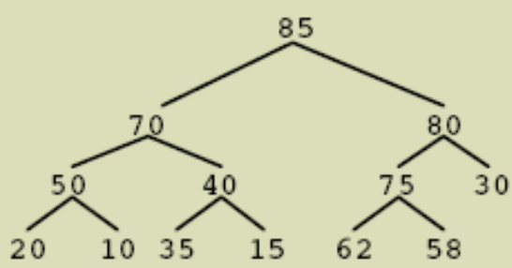
Heap Sort: Array-Based Lists (continued)
Figure 18-57 A list that is a heap
Figure 18-58 Complete binary tree corresponding to the list in Figure 18-57

Slide 58
Build Heap
Method heapify
private void heapify(T[] list, int low, int high)
{
int largeIndex;
Comparable<T> temp =
(Comparable<T>) list[low]; //copy the root node of the subtree
largeIndex = 2 * low + 1; //index of the left child
while (largeIndex <= high)
{
if (largeIndex < high)
{
Comparable<T> compElem =
(Comparable<T>) list[largeIndex];
if (compElem.compareTo(list[largeIndex + 1]) < 0)
largeIndex = largeIndex + 1; //index of the largest child
}

Slide 59
Build Heap (continued)
if (temp.compareTo(list[largeIndex]) > 0) //subtree
//is already in a heap
break;
else
{
list[low] = list[largeIndex]; //move the larger
//child to the root
low = largeIndex; //go to the subtree to
//restore the heap
largeIndex = 2 * low + 1;
}
}//end while
list[low] = (T) temp; //insert temp into the tree,
//that is, list
}//end heapify

Slide 60
Build Heap (continue)
Method buildHeap
private void buildHeap(T[] list, int length)
{
for (int index = length / 2 - 1; index >= 0; index--)
heapify(list, index, length - 1);
}//end buildHeap

Slide 61
Build Heap (continue)
Method heapSort
public void heapSort(T[] list, int length)
{
buildHeap(list, length);
for (int lastOutOfOrder = length - 1; lastOutOfOrder >= 0;
lastOutOfOrder--)
{
T temp = list[lastOutOfOrder];
list[lastOutOfOrder] = list[0];
list[0] = temp;
heapify(list, 0, lastOutOfOrder - 1);
}//end for
}//end heapSort

Slide 62
Analysis: Heap Sort
Number of key comparisons in the worst case
2nlog₂n + O(n) = O(nlog₂n)
Number of item assignments in the worst case
nlog₂n + O(n) = O(nlog₂n)
Number of key comparisons, average case
1.39nlog₂n + O(n) = O(nlog₂n)
Number of item assignments, average case
1.39nlog₂n + O(n) = O(nlog₂n)

Slide 63
Programming Example: Election Results
Write a program to analyze the data of an election and report the winner
There are several divisions
  Each division has several departments
  Each department handles its own voting and directly reports the votes received by each candidate
Program organizes voting data by region, and calculates the total votes received by each candidate and polled for the election

Slide 64
Chapter Summary
Search algorithms
  Sequential search
    Also called linear search
  Binary search
    Works on an ordered set of data
Asymptotic notation: Big-O notation
  Used to compute the efficiency of a given algorithm

Slide 65
Chapter Summary (continued)
Sorting algorithms
  Bubble sort
  Selection sort
  Insertion sort
  Quick sort
  Merge sort
  Heap sort

